Slide 1
Karin Versen
2022
AN AMAZING EDUCATOR

Slide 2
1st Grade Teacher
MEET Mrs. Karin Versen
She is a teacher at Patrick Henry Downtown-Academy Elementary school, and she has been doing amazing things over there for her students. Before the pandemic, she would walk her class to the Main Library on Olive, once a week for read alouds and reading opportunities, as well as live performances.

Slide 3
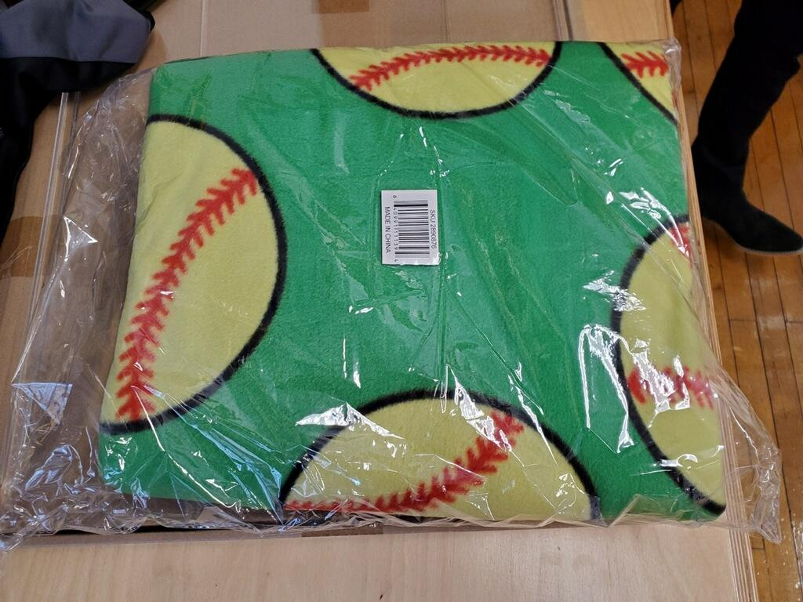
WOW!!!!
Ms. Versen makes sure her students have the necessities they need at home. She connects with HomeWorks for donating and delivering the necessary material to the home of her students. Look at these wonderful books and the nice comfy blanket.

Slide 4
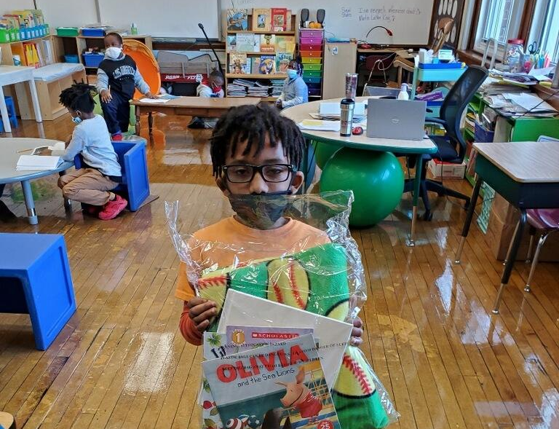
He is ready!!

Slide 5
Please check out her Donors Choose Page.
Mrs. Versen writes projects, and submits them to Donor’s Choose, for necessities for her students and classrooms, such as Kleenex, paper towels, hand sanitizer, wipes, comfy and flexible furniture. She has replaced all of her classroom furniture through Donor’s Choose. “Flexible seating allows me to pair each child with the most ideal seating for them. We have wobble stools which allow kids constant motion while remaining in their assigned areas. One of my students balances himself on top of his stool on his knees while listening to group instruction. Another student spins on her stool. Both are completely focused when it comes time for independent work. We have soft stools with balls under them. We have balls kids can bounce on all day, without the ball going anywhere. The students love those chairs and I have more control over the safety aspect since they are with me,” said Mrs. Versen
Follow the link!

Slide 6
Comfortable, safe and engaged!

Slide 7
What a great view and what great things Mrs. Versen is doing!

Slide 8
Thank You!
Karin Versen, for all you are and do for our students and families.
“My motivation is that I try to stay on top of current trends and data. I want to make our classroom a place kids can’t wait to get to. A place they love and in which they feel comfortable. I want to do anything I can to help them develop a love for learning,” says Mrs. Versen.

